Slide 1
Weekly report: Feedback & Lidar – Assisted Controller
Week number: 11
Date: 09/12/2025
Supervisor: Prof. Dr.-Ing. David Schlipf
Group members: Mirza Dincer, Saurabh Pankaj Jha, Midhun Kanichattu Venu
Presenter: Saurabh Pankaj Jha

Slide 2
List of Contents
Tasks of the week
Results of Steady States calculation for Optimus project
Saurabh Pankaj Jha

Slide 3
Tasks of the Week
Adjusting torque controller
Calculating steady states for the Optimus project.
Saurabh Pankaj Jha

Slide 4
Simulation Setting
600 seconds of simulation.
Wind speeds from 1 m/s to 25 m/s, with increments of 1 m/s
Only enabled Rotor DOF and First fore-aft tower bending-mode DOF.
Initial conditions of pitch angle, rotor speed and fore-aft tower position for every corresponding wind speed.
Torque controller adjusted for Optimus Syria
Saurabh Pankaj Jha

Slide 5
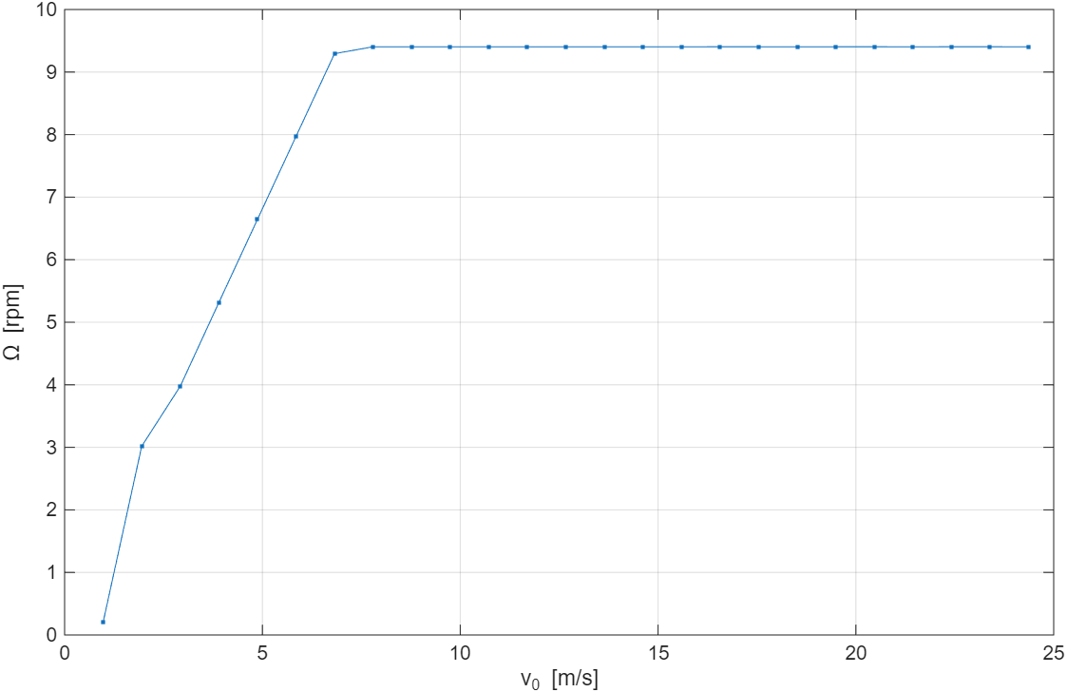
Rotational Speed
Saurabh Pankaj Jha

Slide 6
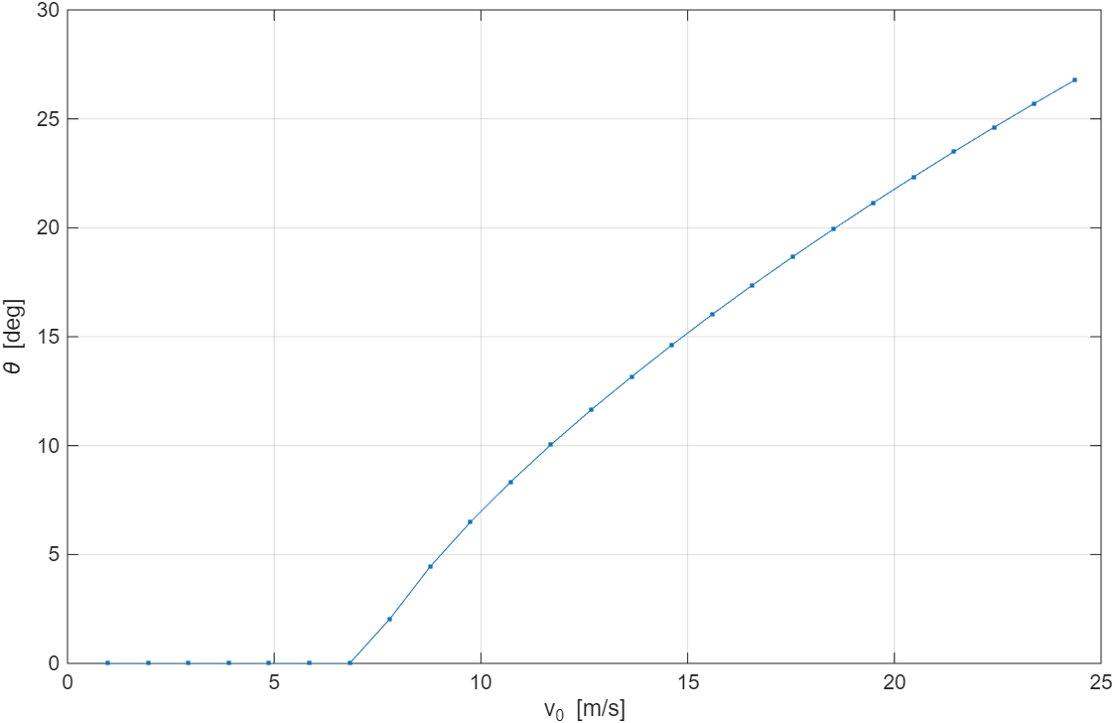
Pitch Angle
Saurabh Pankaj Jha

Slide 7
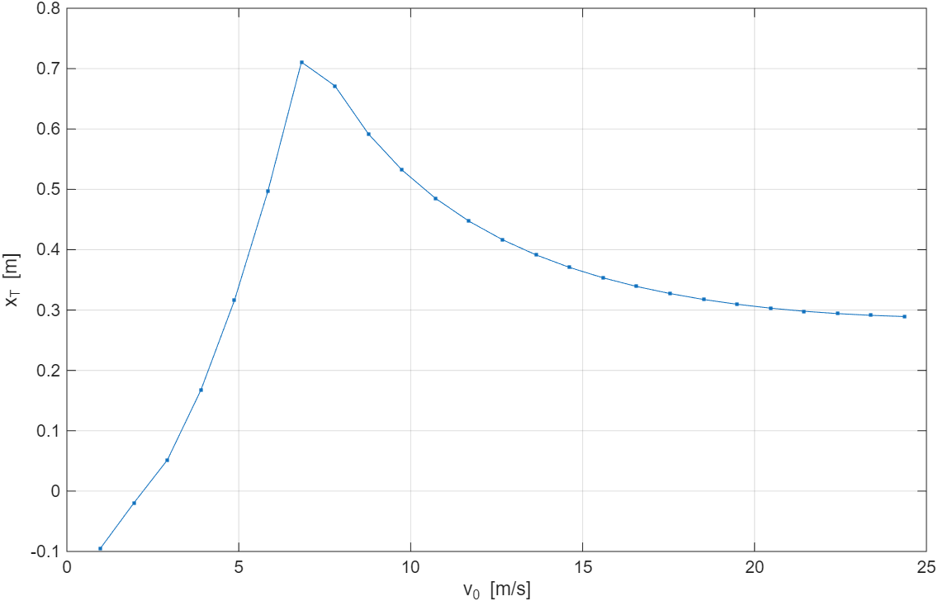
Tower Top Displacement
Saurabh Pankaj Jha

Slide 8
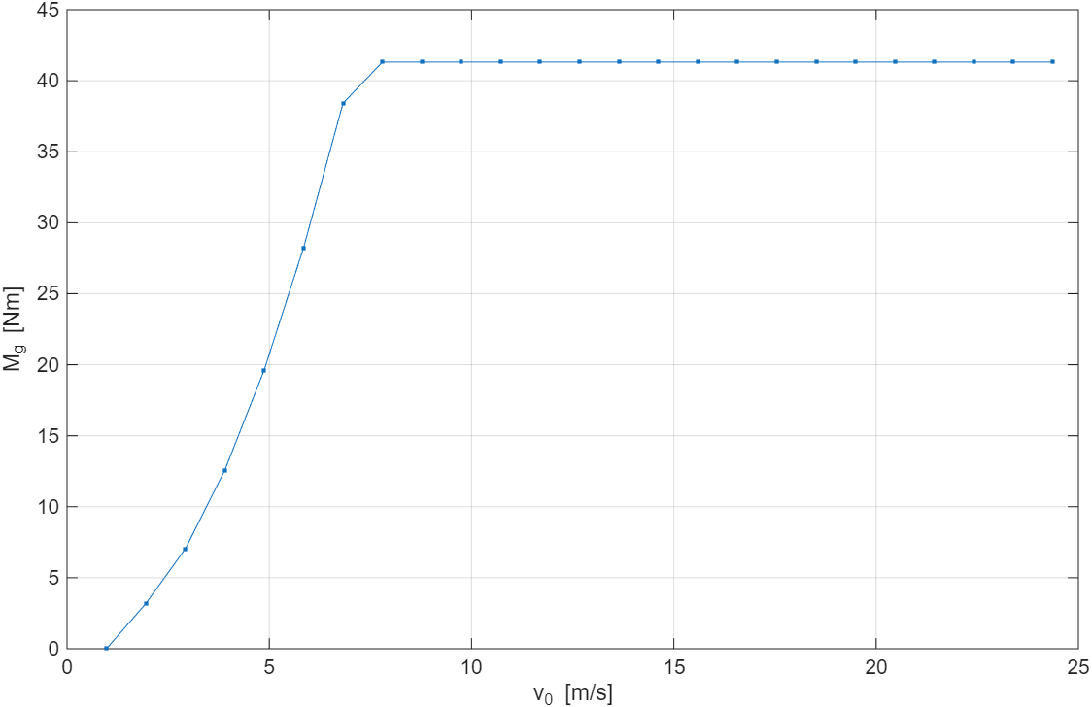
Generator Torque
Saurabh Pankaj Jha

Slide 9
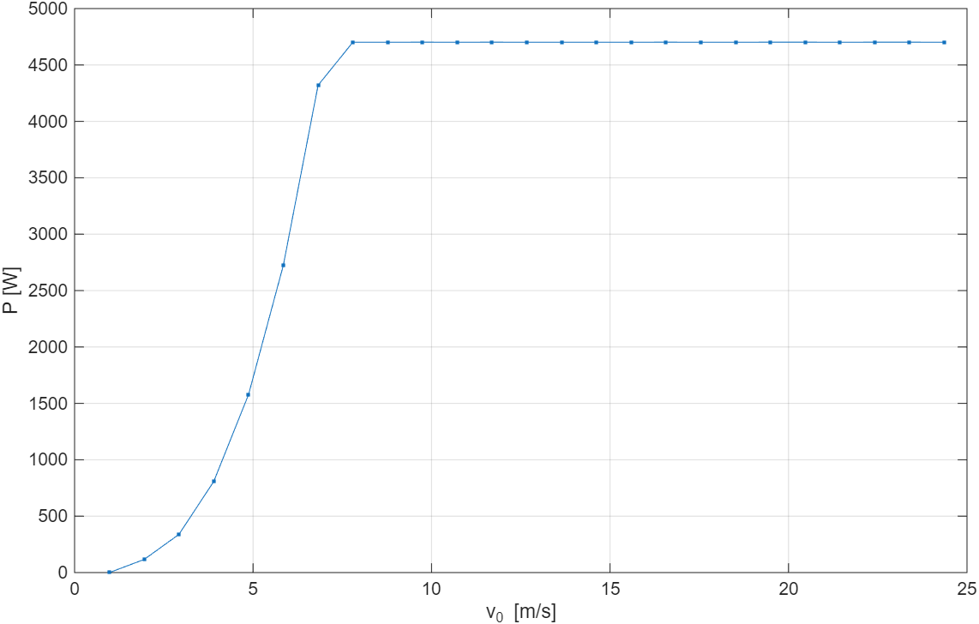
Power Curve
Saurabh Pankaj Jha

Slide 10
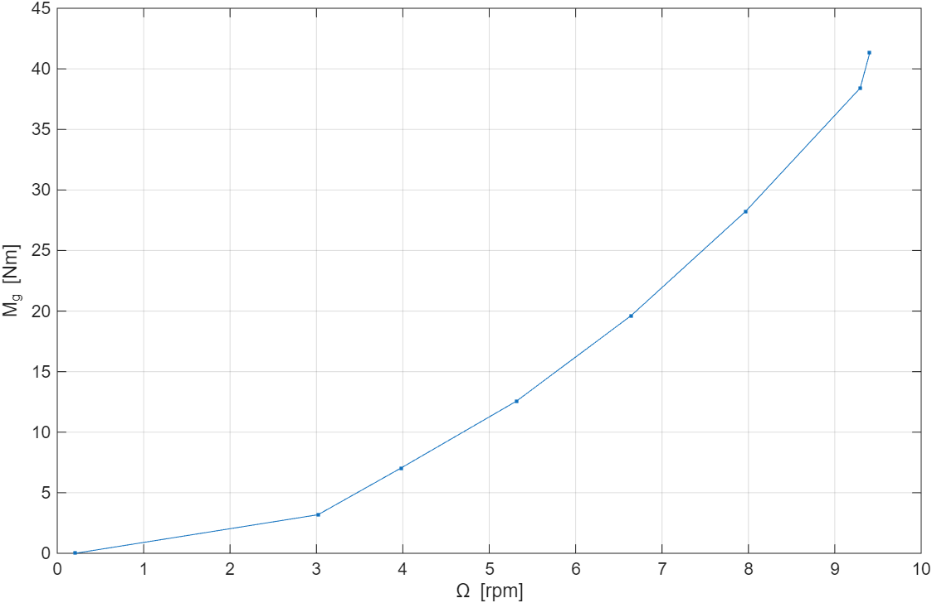
Rotational Speed - Torque Curve
Saurabh Pankaj Jha

Slide 11
Conclusion
Torque controller and steady states needs to be updated.
Next weeks:
Finalize steady states.
Show torque and pitch controller results.
Find the optimal gain-schedule table for pitch controller
Adjust static pitch curve for feedforward pitch controller and verify by EOG.
Determine best lidar measurement distance.
Determine the cut-off frequency of low pass filter in feedforward pitch controller.
Verify results by turbulent wind simulations.
Saurabh Pankaj Jha

